Slide 1

Functions

Slide 2
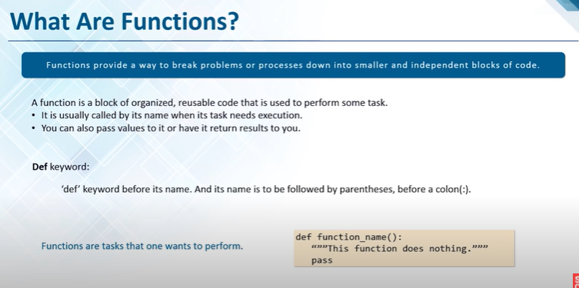

Slide 3

Python method is like a function, except it is attached to an object.
We call a method on an object, and it possibly makes changes to that object.
A method, then, belongs to a class.
Python function is a sequence of statements that execute in a certain order, given a name.
They let us implement code reusability.
https://rb.gy/sgg9hj
Python Method Vs Function

Slide 4
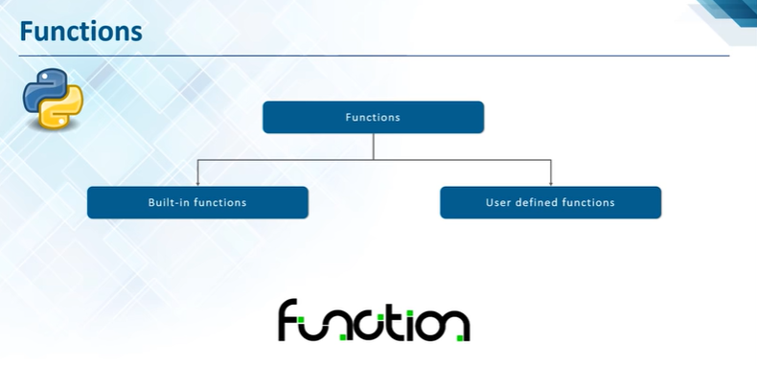

Slide 5
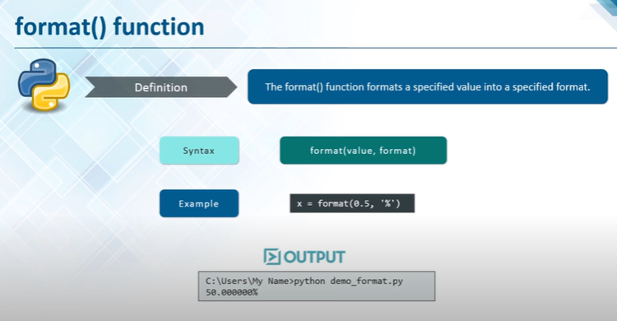

Slide 6
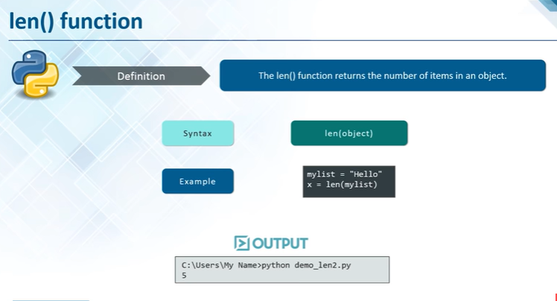

Slide 7
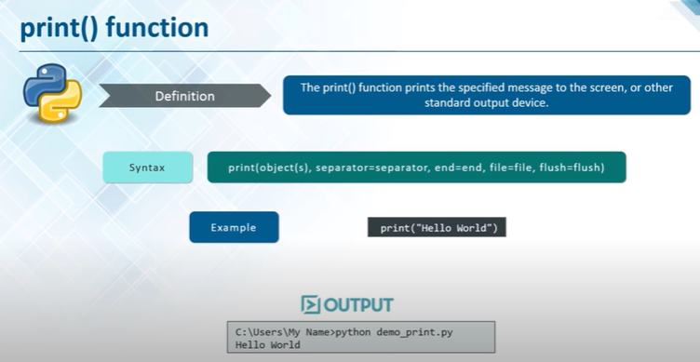

Slide 8
Function name - to uniquely identify the function. Function naming follows the same rules of writing identifiers in Python.
Parameters (arguments) through which we pass values to a function. They are optional.
A colon (:) to mark the end of the function header.
Optional documentation string (docstring) to describe what the function does.
One or more valid python statements that make up the function body. Statements must have the same indentation level (usually 4 spaces).
An optional return statement to return a value from the function.
Parameters or arguments?
A parameter is the variable listed inside the parentheses in the function definition.
An argument is the value that is sent to the function when it is called.
Function's components

Slide 9
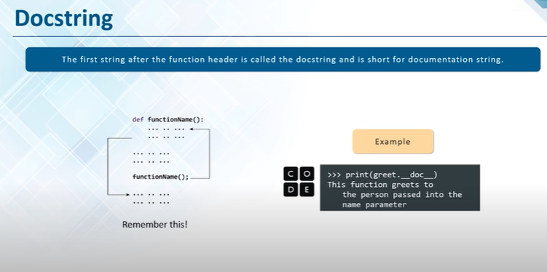

Slide 10
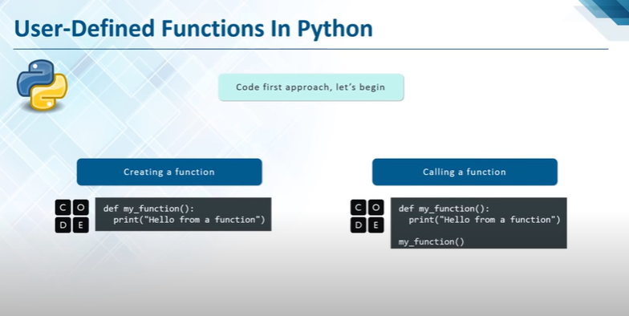

Slide 11
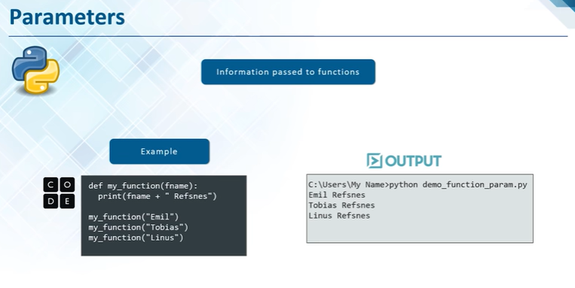

Slide 12
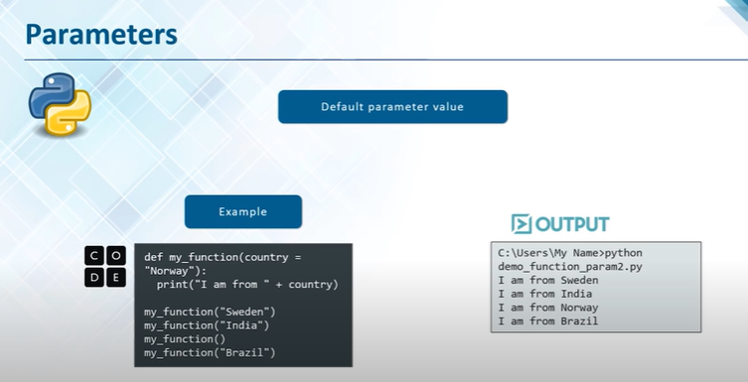

Slide 13
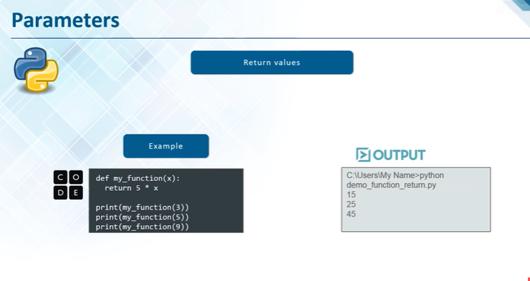
https://tinyurl.com/27ke7rt5

Slide 14
Arbitrary Arguments, *args
If you are not sure of how many arguments will be passed into your function
declaration, simply add a * before the parameter name in the function definition.
This way the function will receive a tuple of arguments, and can access the items accordingly:
Example
If the number of arguments is unknown, add a * before the parameter name:
def my_function(*presidents):
print("The name of the first president of Ghana was: " + presidents[2])
my_function("Dr. Kenneth Kaunda", "Mwalimu Julius Nyerere", "Dr. Kwame Nkrumah")
Note: Arbitrary Arguments are often shortened to *args in Python documentations.
Keyword Arguments
We can also send arguments with the key = value syntax.
This way the order of the arguments does not matter.
def my_function(Engi3, Engi2, Engi1):
print("The youngest Scientist was: " + Engi3)
my_function(Engi1 = "Galileo", Engi2 = "Newton", Engi3 = "Einstein")

Slide 15
Arbitrary Keyword Arguments, **kwargs
If you do not know how many keyword arguments that will be passed into your function,
add two asterisk: ** before the parameter name in the function definition.
This way the function will receive a dictionary of arguments, and can access the items accordingly:
Example
If the number of keyword arguments is unknown, add a double ** before the parameter name:
def my_function(**activist):
print("His last name was: " + activist["lname"])
my_function(fname = "Malcolm", lname = "X")
Note: Arbitrary Kword Arguments are often shortened to **kwargs in Python documentations.

Slide 16
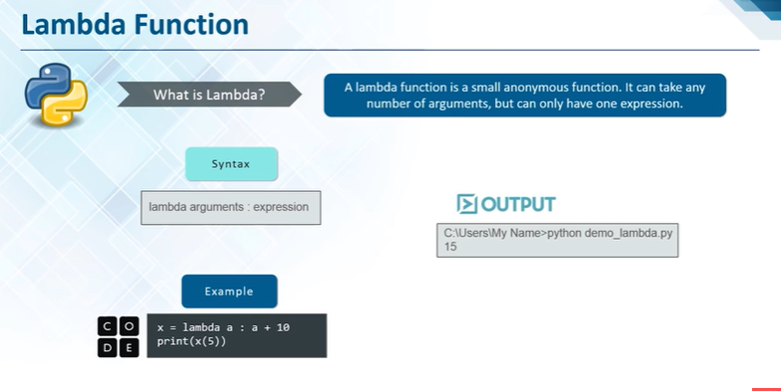

Slide 17
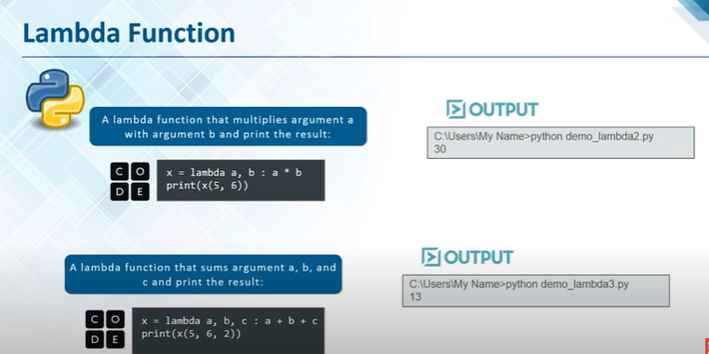

Slide 18
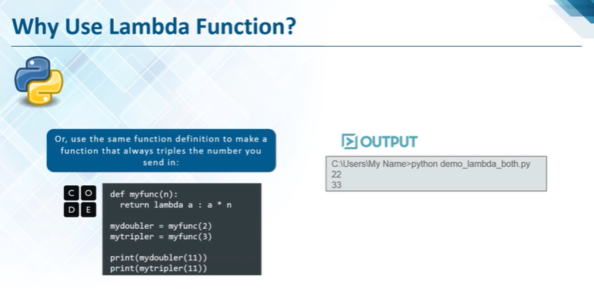

Slide 19
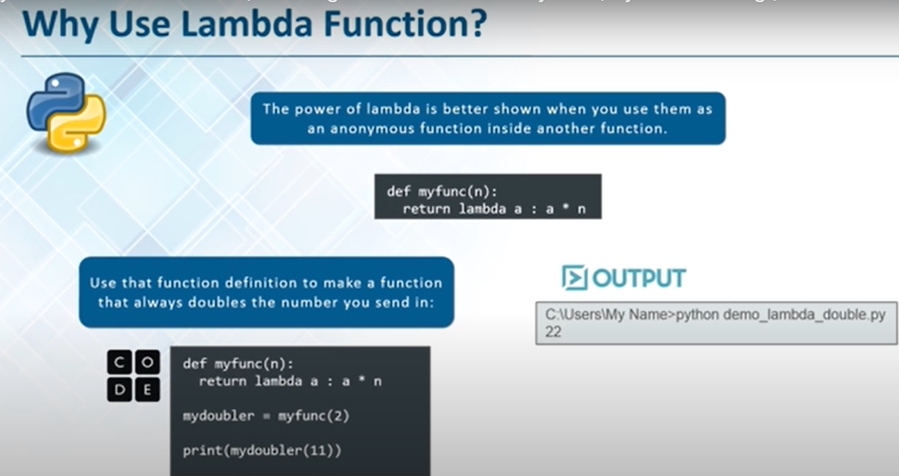

Slide 20
Classes & Objects

Slide 21
What is a Class?
A class is a blueprint for how something should be defined with its attributes.
Classes do not contain any data.
While the class is the blueprint, an instance is an object that is built from a class
and contains real data.
An object is a collection of data (variables) and methods (functions) which act on the data itself.
An object is also an instance of a class and the process of creating this object is
called instantiation.
An object contains data, like the raw or pre-processed materials at each step on
an assembly line, and behavior, like the action each assembly line component performs.
For instance, an object could represent a Person with properties like a name, age, email
address and address and behaviors such as walking, talking, breathing, and running.

Slide 22
Classes must haves
__init__
Is a method or constructor in python
The __init__() function is called automatically every time the class is being used to create a new object.
All classes have the __init__ method. We normally use it to initialize all the variables
The first string inside the class is called docstring and has a brief description about the class.
Although not mandatory, this is highly recommended.
Self
Is an instance or an object of a class. In Python, this is explicitly included as the first parameter.
It helps to differentiate between the methods and attributes of a class with local variables.
Python class names are written in Capitalized Words notation by convention

Slide 23
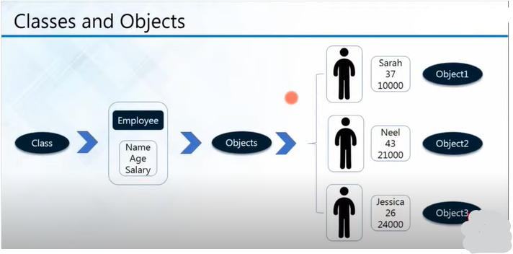
Objects are instances of the class

Slide 24
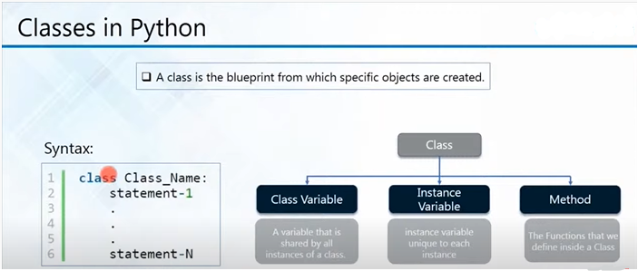
https://tinyurl.com/27ke7rt5

Slide 25
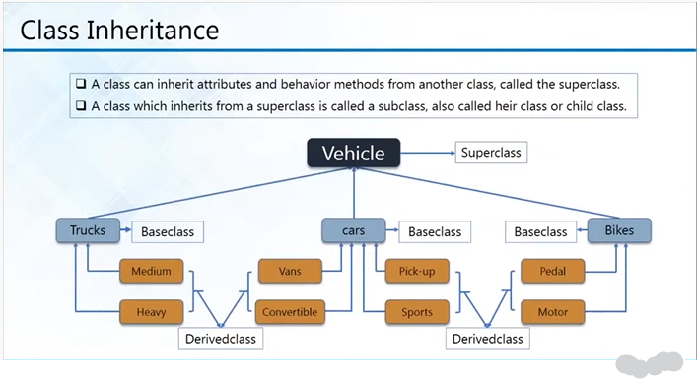

Slide 26
